Slide 1

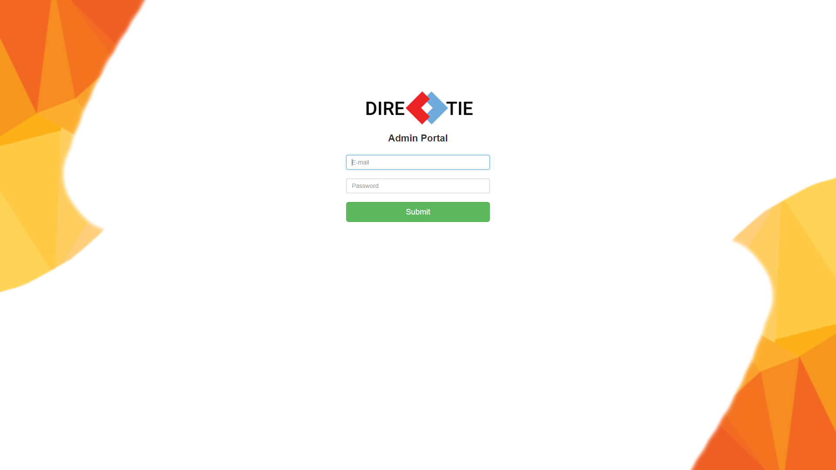


DIRECTIE
Presented by:
Chua Wei
Chia Kwee Cheng
Ng Hong Yao
Garick Chong Jun Kang
Tay Wei Sern

Slide 2
Outline
Problem Statement
Objective
Features
Video
System Architecture
Project Demonstration
Improvements & Challenges
Question & Answer Session

Slide 3
The Problem Statement
The visually impaired may be unfamiliar with the environment and thus, get lost easily. Although there are helpers to guide them around, they may not be always there.

Slide 4
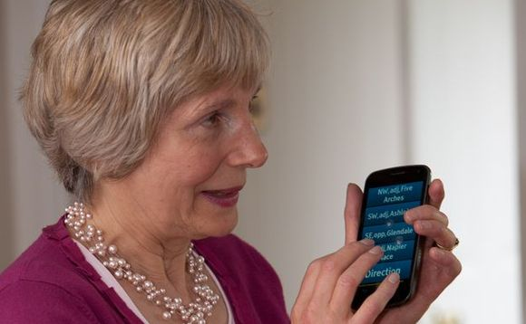
Objective
Assist the Visually Impaired in navigation within an indoor environment through a mobile application.

Slide 5


Slide 6
Main Features (Mobile App)
Speech Assistant
Detect user’s current location
Shortest path navigation
View more details on facility

Slide 7
Main Features (Web App)
Manage dashboards
Manage beacons
Manage facilities & units

Slide 8
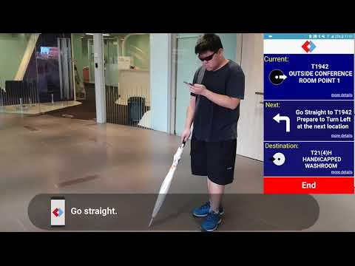
Video

Slide 9
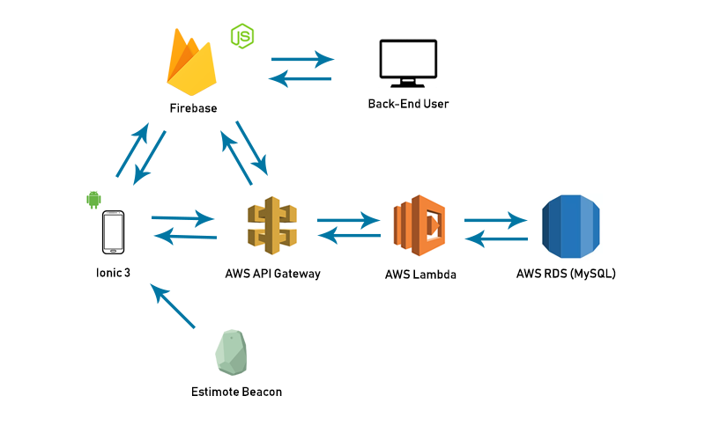
System Architecture
Notes:
no time to test for other devices

Slide 10
Project Demonstration
Notes:
http://web.airdroid.com/

Slide 11
Future improvements
Support more devices
More options for dashboard
Support WiFi beacon
Built in map to the app for non VI users
Notes:
no time to test for other devices

Slide 12
Challenges & How We Overcame It
Duplicate images in Unit table
Displaying too many one-to-many records in a table (e.g. Beacon Relation)
Amazon Web Service (AWS)
Progressive Web App (PWA)
Notes:
Ws talk about the phone bearing setup, and the distance and bearing approximation (+/-) through testing
Talk about the text to speech, like the callback Switch from pwa to mobile app, without any platform Accuracy is the most challenging part,

Slide 13
Challenges & How We Overcame It
Knowing the person’s facing direction
Text-to-speech overlapping
Accuracy
UI/UX
Distance & Bearing approximation
Notes:
Ws talk about the phone bearing setup, and the distance and bearing approximation (+/-) through testing
Talk about the text to speech, like the callback Switch from pwa to mobile app, without any platform Accuracy is the most challenging part,

Slide 14
Questions

Slide 15
Thank You

